Slide 1
Data Spark - IIIuminating Insights for Global Electronics
Capstone Project – 2
By:
Pranavu P

Slide 2
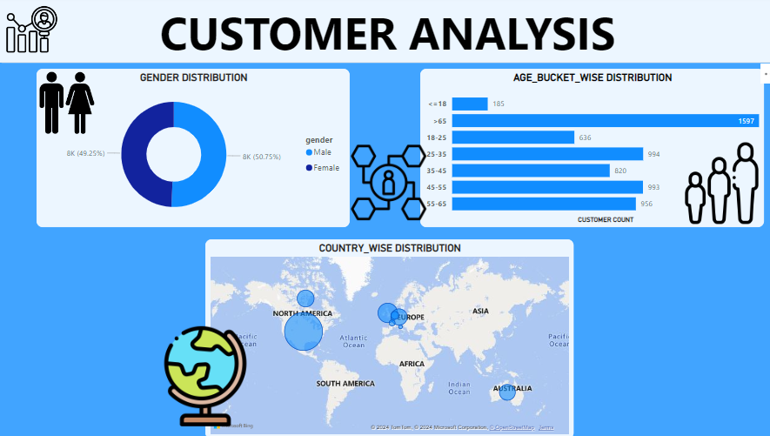
Customer Analysis
Gender Analysis:
There is a noticeable dominance of male customers compared to female customers
Implementing advertisements targeted toward women can help address this imbalance and drive overall sales growth.
Age Analysis:
Customers have been grouped into age brackets and visualized using a bar chart.
The data shows that individuals over the age of 65 are more numerous compared to other age groups.

Slide 3

Customer Analysis
Country wise Analysis:
Location-based data was visualized on a world map, where bubble size represents the sales intensity from each region.
The analysis indicates that North America leads with the highest sales among all countries.

Slide 4
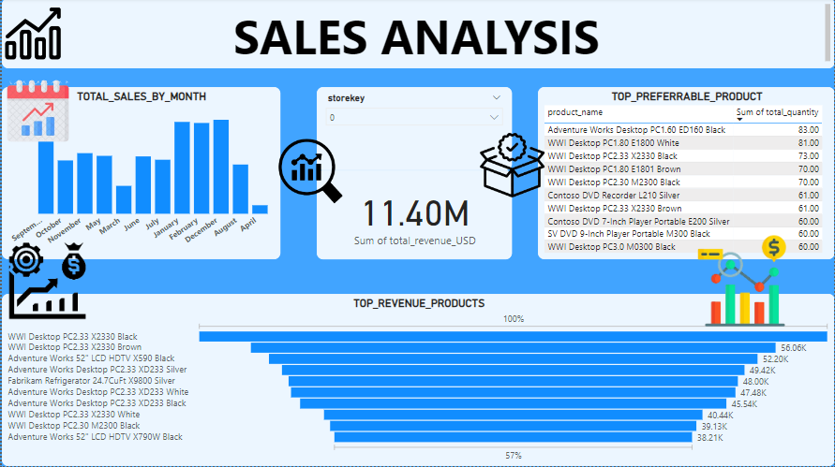
Sales Analysis
Monthly sales:
Sales peak in January, February, and December, indicating that inventory should be well-prepared to meet the surge in demand during these months.
In contrast, April and March have recorded the lowest sales, which can be improved through effective marketing strategies and a strong product portfolio.
Top Preferrable products:
Computers stand out as the top performers. Maintaining a well-managed SKU selection based on colors is crucial, as there is a healthy distribution of sales across various colors.

Slide 5
Sales Analysis

Slide 6
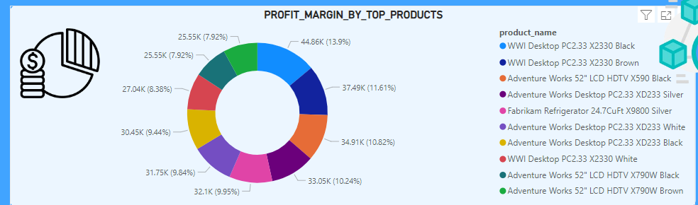
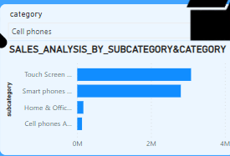
Product Analysis
Profit Margin by Top Products:
The donut chart for the top 10 products shows a well-balanced distribution, indicating that the profit margins across these products are evenly spread, which is a positive sign.

Slide 7
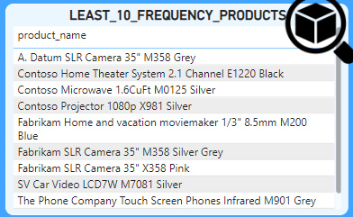
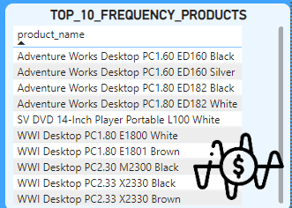
Product Analysis
Least 10 Frequency Products:
A significant portion of the bottom 10 products in terms of frequency comes from the home appliances and camera segments.
Conducting a competitor analysis can help identify gaps in our current offerings and provide insights for improvement.
Top 10 Frequency Products:
The best-selling products are primarily from the desktop and computer segments
It is advisable to keep adequate inventory levels to satisfy customer demand.

Slide 8
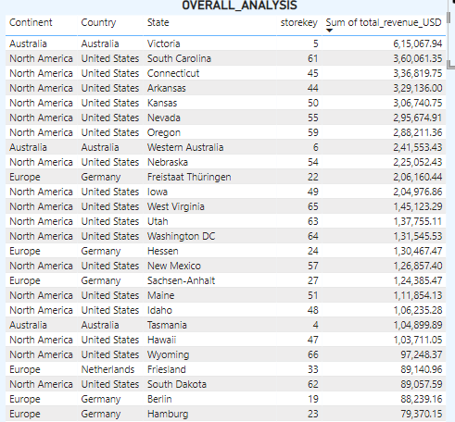
Store Analysis
Overall Analysis:
The total revenue indicates that sales from North American stores are the highest.
However, the limited number of stores in Australia presents a missed opportunity.
Expanding the company's presence in Australia could significantly boost sales.

Slide 9
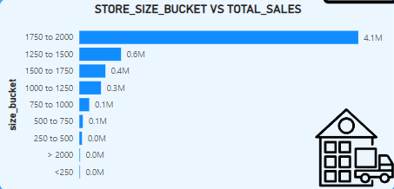
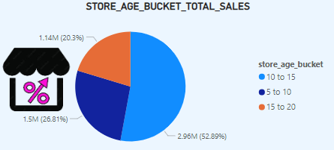
Store Analysis
Store Size analysis:
Stores with an area between 1,750 and 2,000 square feet contribute to over 50% of total sales.
Interestingly, the largest stores do not necessarily have the highest sales figures.
Store Age analysis:
Stores aged between 10 and 15 years contribute the highest sales amounts.

Slide 10
Thank You

